Slide 1

Fast Weighted Median Filtering
Team: Lumos
Nikhil Bansal Gulshan Kumar
20161065 20161082
CSD CSD
Mentor TA: Aditya Aggarwal
Project Repo ​https://github.com/gulshan-mittal/Fast-Weighted-Median-Filter

Slide 2
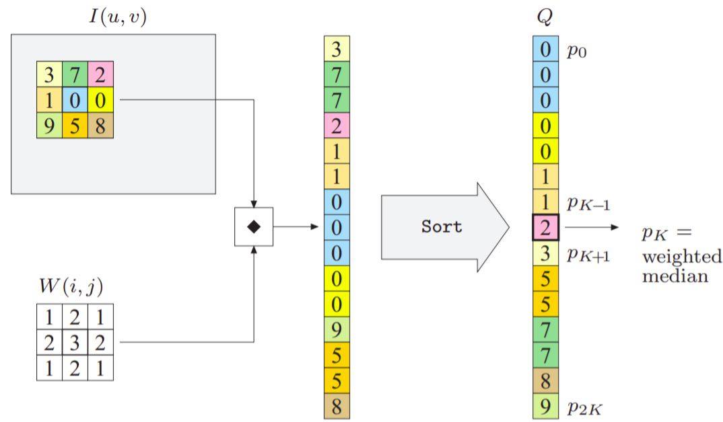
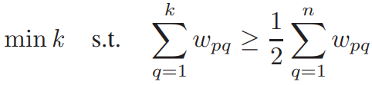
What is Weighted Median Filtering?
Intensities in current window:
{3, 7, 2, 1, 0, 0, 9, 5, 8}
The, weights associated with above intensities
{1, 2, 1, 2, 3, 2, 1, 2, 1}
Sort the intensities.
Then, the median is intensity at kth position:

Slide 3
Project Goals
Re-implement weighted median filtering in efficient manner referencing research paper.
Reduce time complexity of weighted median filtering (WMF) from O(r*r*log(r)) to O(r), where r is the size of the kernel.
Showing different applications of Weighted median filtering

Slide 4
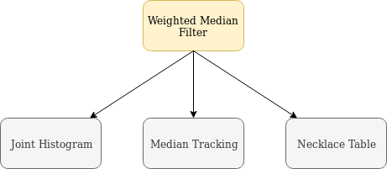
Algorithm overview
Improvement Strategies
Joint Histogram to use box filtering
Median tracking to cut cumulative histogram procedure
Necklace table for fast data access in sparse table

Slide 5

Joint Histogram
A joint histogram is a 2D histogram structure for storing pixel count. Each row corresponds to the feature index and each column corresponds to the intensity value of the pixel and each Histogram block stores the count of pixels corresponding to that intensity value and feature.
This counting scheme enables fast weight computation even when the window shifts.
The total weight for all pixels with value index i is :

Slide 6
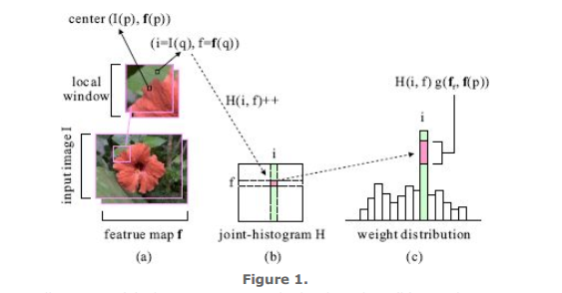
Joint Histogram
Algorithms
Median Finding
Shift and Update
Joint-histogram illustration. (a) The input image and a local window. (b) Joint-histogram containing all pixels in the window according to value index ​i ​ and feature ​f ​(c) Total weight calculated for each ​i

Slide 7
Median Tracking
Median Tracking basically exploits the property that almost all images have similar feature in the adjacent median finding windows to iterate over joint-histogram in a much efficient way.

Slide 8
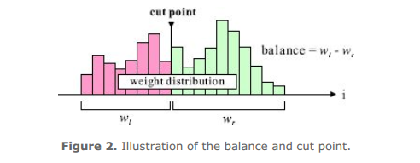
Cut Point & Balance
For median tracking, we define two terms: Cut Point and Balance where the cut point is a point where cumulative sum reaches half of the total sum and balance is absolute min difference between the left weight and right weight.

Slide 9
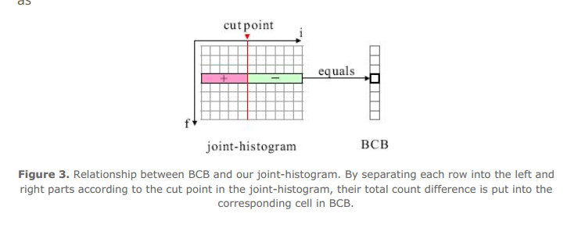
Balance Computation Box (BCB)

Slide 10

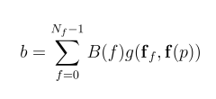
Balance Computation Box (BCB)
Stores the difference of pixel numbers on the two sides of the cut point in the corresponding row of the joint-histogram.
Using BCB balance can be calculated as:
where g(f_{f}, f(p)) is a weight map.

Slide 11
Necklace Table
Exploit the data sparsity in joint histogram and BCB
Reduces the required space as well as time required to access a particular value.
O(1) data access
O(1) element insertion
O(1) element deletion

Slide 12
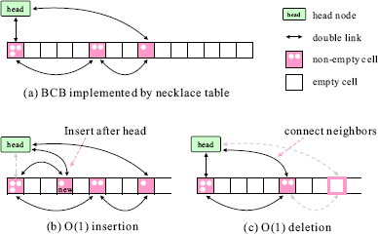
Necklace Table
Figure 4. Demonstration of the necklace table.

Slide 13
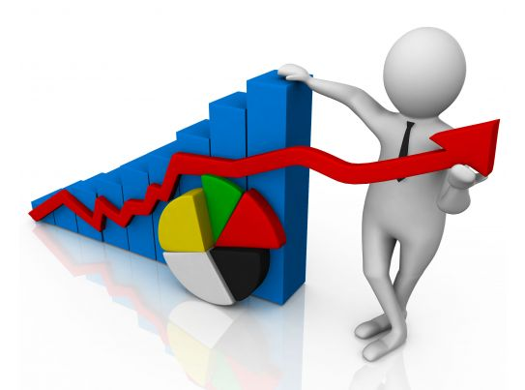
Results Obtained

Slide 14
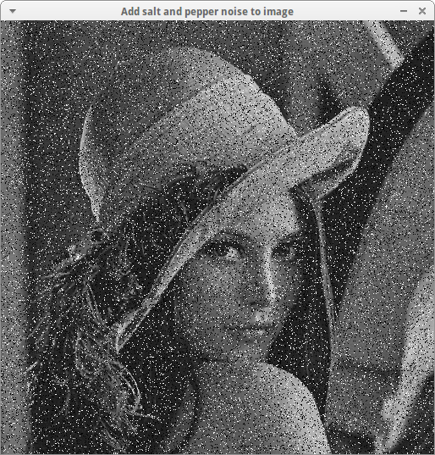
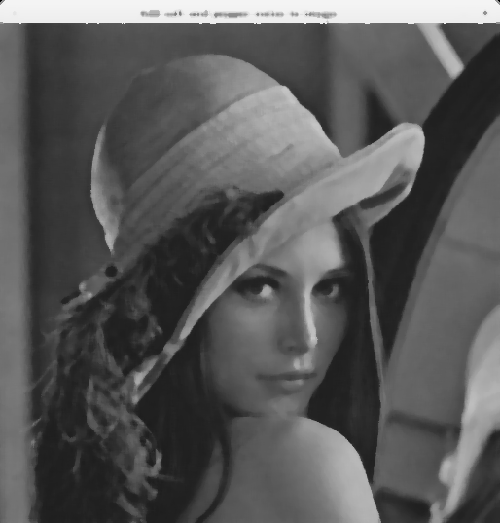
Salt & Pepper Denoising

Slide 15
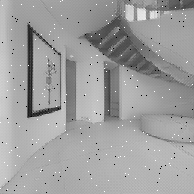
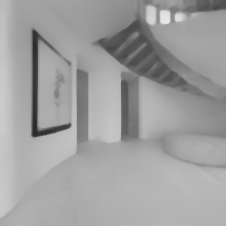
Salt & Pepper Denoising (Gibson dataset)

Slide 16
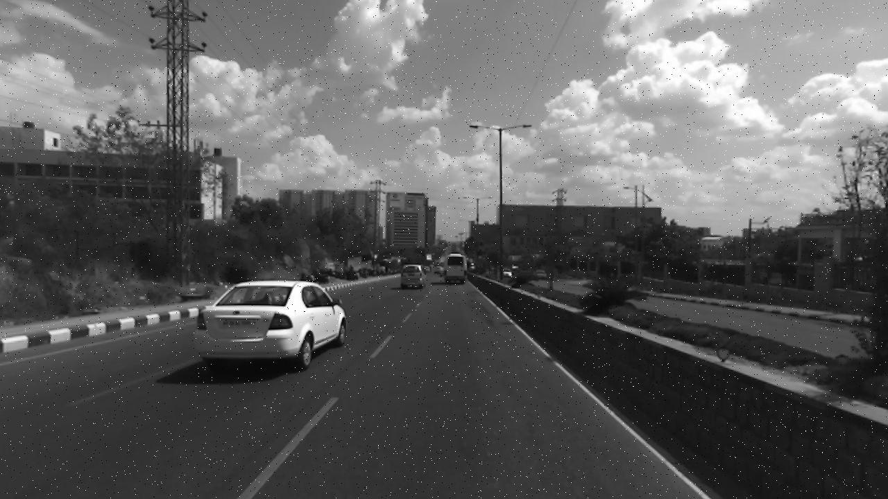

Salt & Pepper Denoising (Indian dataset)

Slide 17
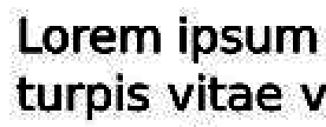


JPEG Artifact Removal
Gaussian Kernel with Radius 10
Gaussian Kernel with Radius 32

Slide 18
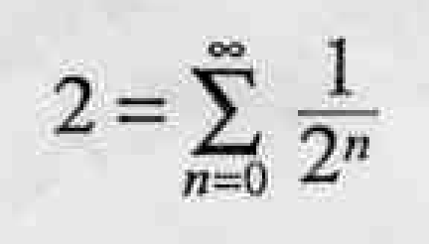
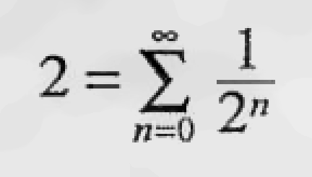
JPEG Artifact Removal
Gaussian Kernel with Radius 20

Slide 19
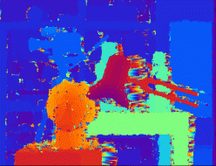
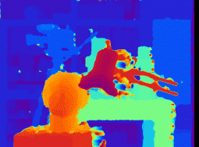
Improve Disparity Map

Slide 20

Analysis

Slide 21
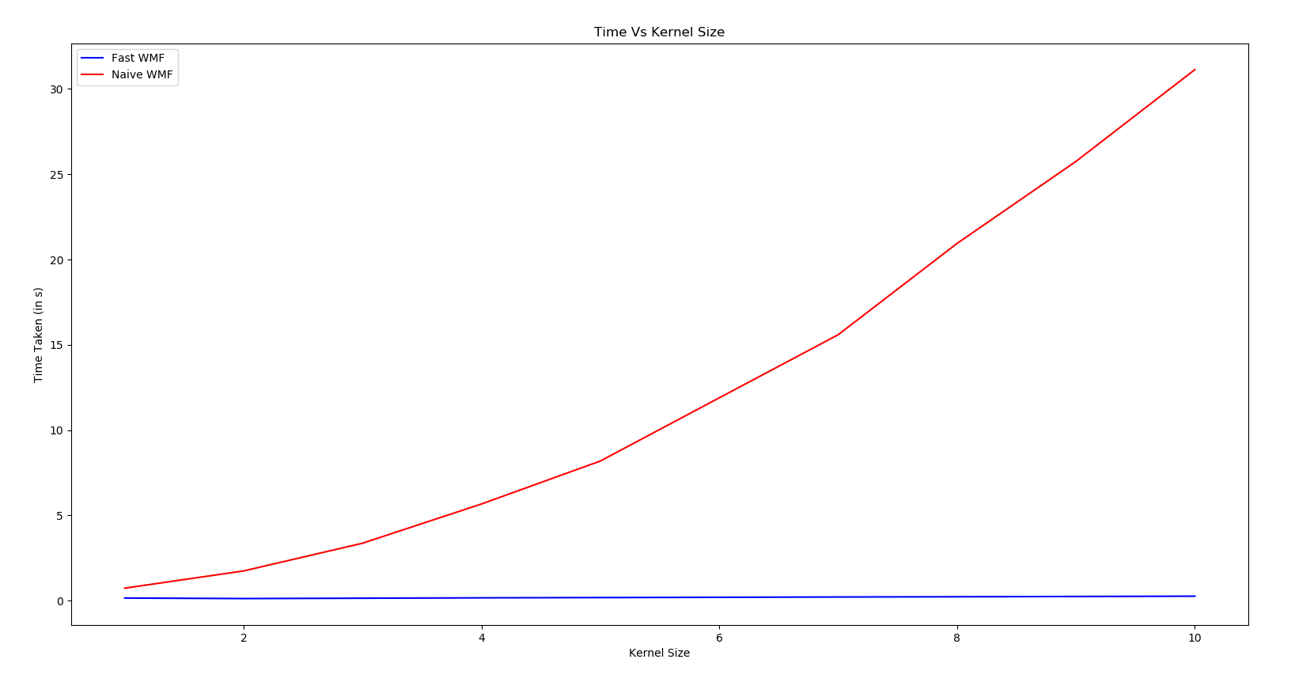

Time Vs kernel Size

Slide 22
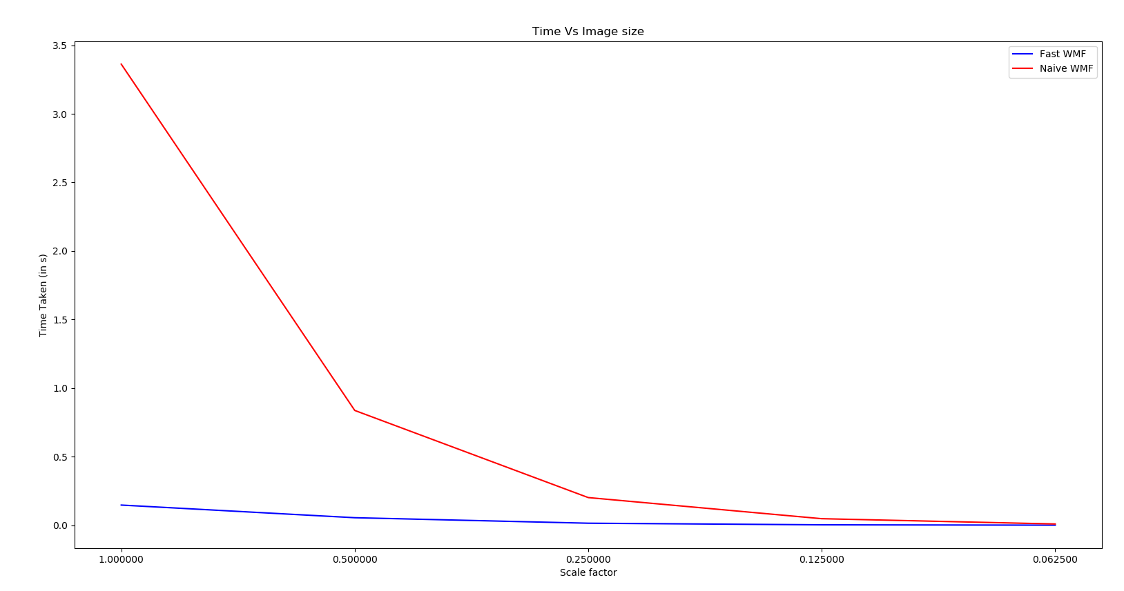
Time Vs Image Size (Scale)

Slide 23
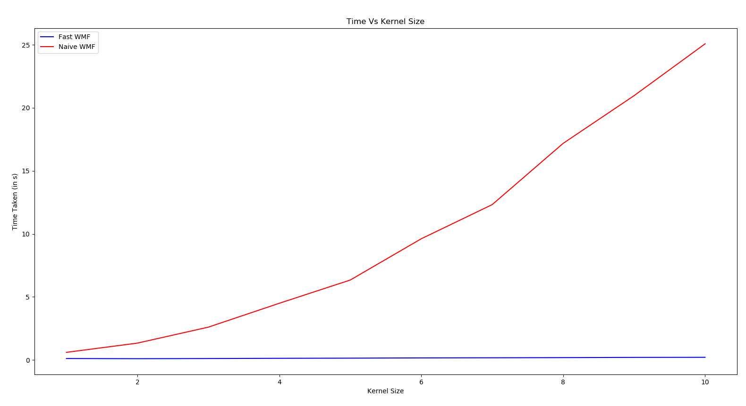
Time Vs kernel Size (Gaussian Kernel)

Slide 24
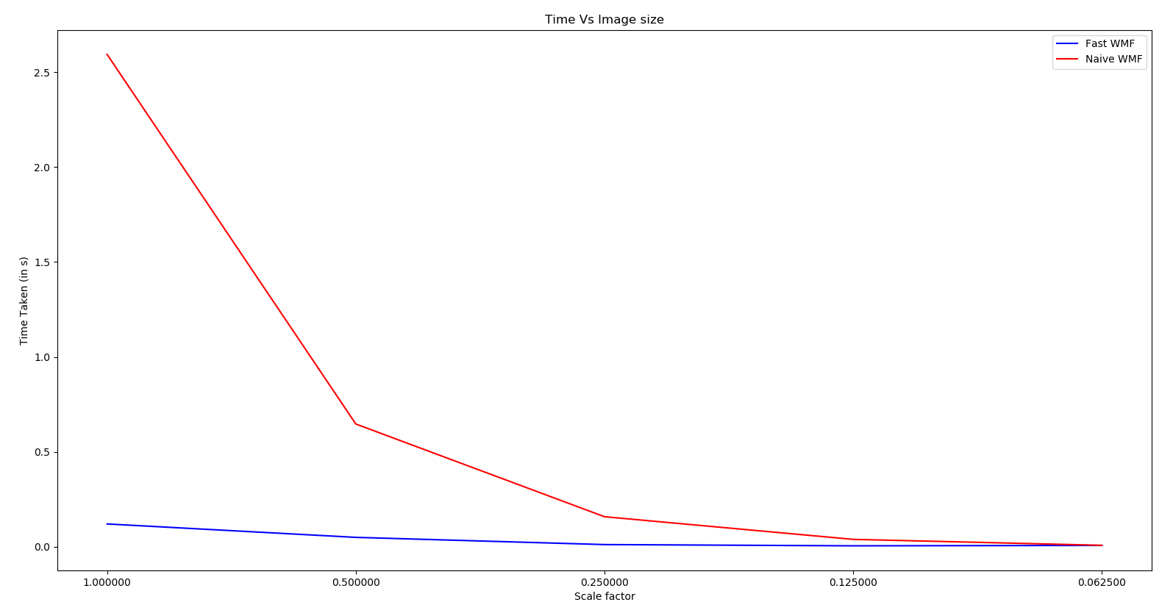
Time Vs Image Size (Gaussian Kernel)

Slide 25
Work Distribution
Gulshan Kumar
Understand and implement a Joint Histogram data structure (initially without Necklace Table) and corresponding algorithms and initial implementation of WMF using only joint histograms.
Implement Joint Histogram and BCB using Necklace Table class.
Results, Analysis & plots
Nikhil Bansal
Understand and code Balance count box (without Necklace table) and corresponding algorithms taking into account the joint histogram.
Implement class for the Necklace table which will be extended to both Joint Histogram and BCB.
Baseline: Naive Implementation

